Slide 1
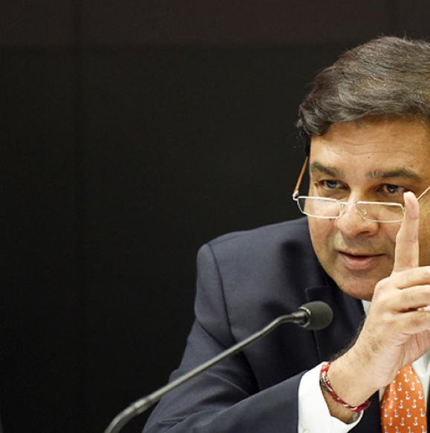
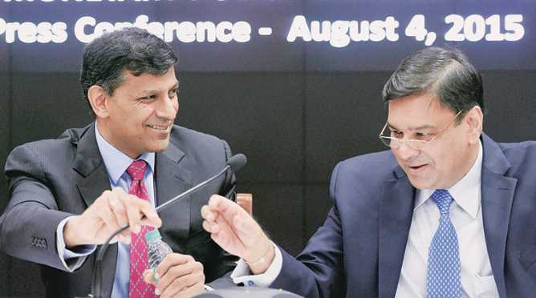
Monetary Policy: Tools
Quantitative/Gen./Indirect
Qualitative: Selective, Direct
Reserve Ratios (CRR, SLR)
Margin / LTV
OMO & MSS
Rates: Bank, MSF, LAF [Repo, RR]
Consumer Credit control / EMI
Selective Credit Control (SCC), Credit ceiling & Rationing, PSL
Moral Suasion & Direct Action
Now: Review of last year’s Policies

Slide 2
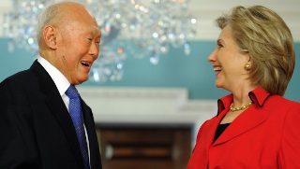


3 ways of making monetary policy
Exchange rate stability
Multiple Indicators
Singapore & other export oriented economies.
Growth
Employment
Inflation WPI,CPI
Exchange rate
Inflation targeting
Repo>CPI
2-6% CPI (all India)
Other indicators fall in line. Successful in western nations.

Slide 3
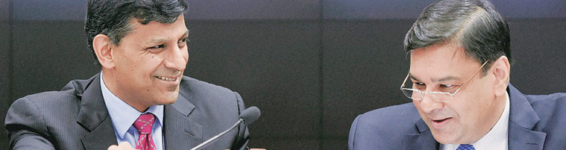


2013-14
Gov Rajan forms Urjit Committee to review Monetary Policy
2016
RBI Act amended to provide for MPC & inflation targeting
2016, Oct
Urjit’s first policy
MPC’s first policy
2016-2020
2-6% CPI
All India

Slide 4
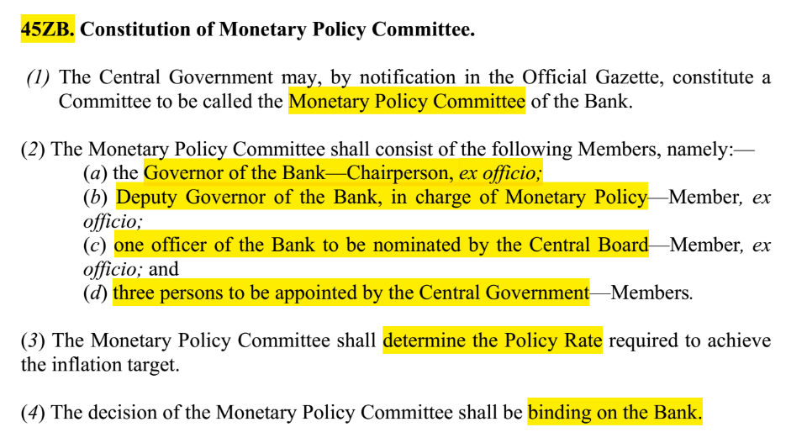
GSM2: Statutory, regulatory bodies: RBI Act

Slide 5
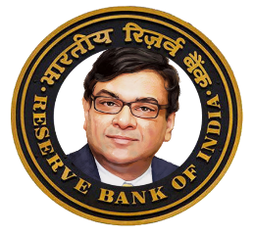
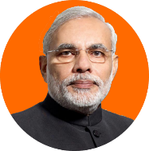
MPC:6 members| quorum 4 members- incl. governor.
Dr.Urjit Patel [Ex-officio Chairman, Casting vote]
RBI side
Chetan Ghate, @Indian Statistical Institute;
Govt Nominated [4 year term; no reappointment]
Pami Dua, @Delhi School of Economics
Ravindra H Dholakia @IIM-A
Dy.G. R.Gandhi [MP Dept]
Exe.Dir. Michael Patra [nominated by RBI central board]
HW: comparison
Who has casting LS/RS?
What’s the quorum in parliament?
Is there quorum requirement in SLA?
Government can send message only in writing.

Slide 6
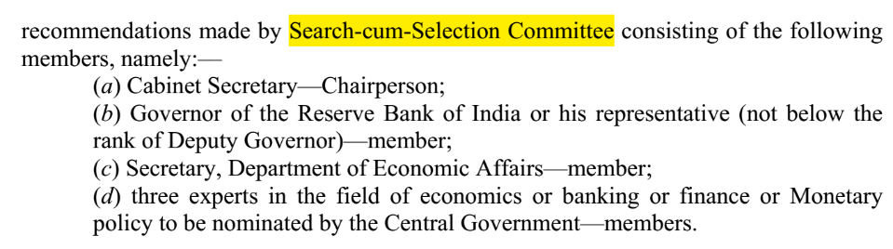
Who selects members for Government to nominate?

Slide 7
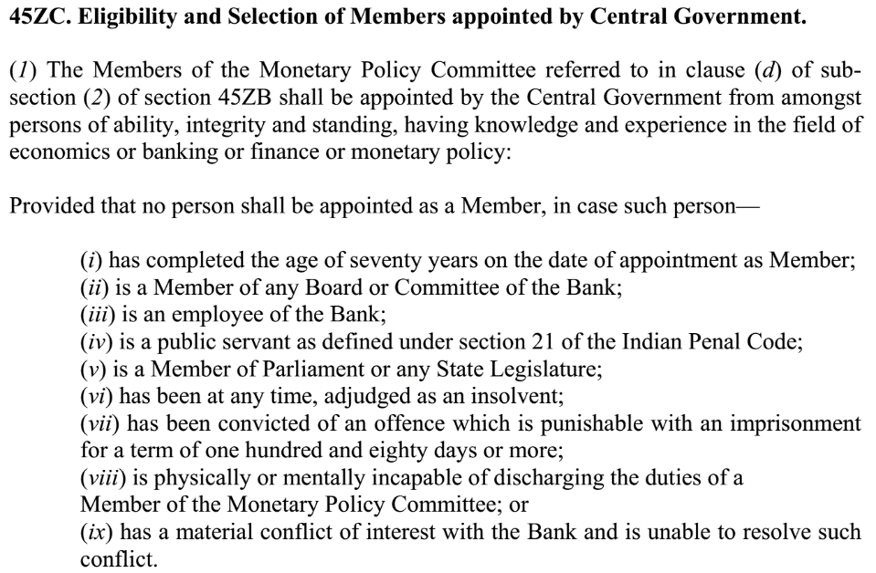

Slide 8
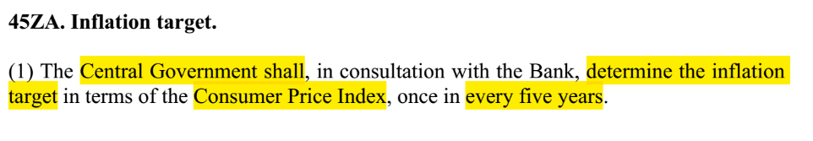
target
2016-2020 [31stMarch 2021]
2%
4%
6%

Slide 9

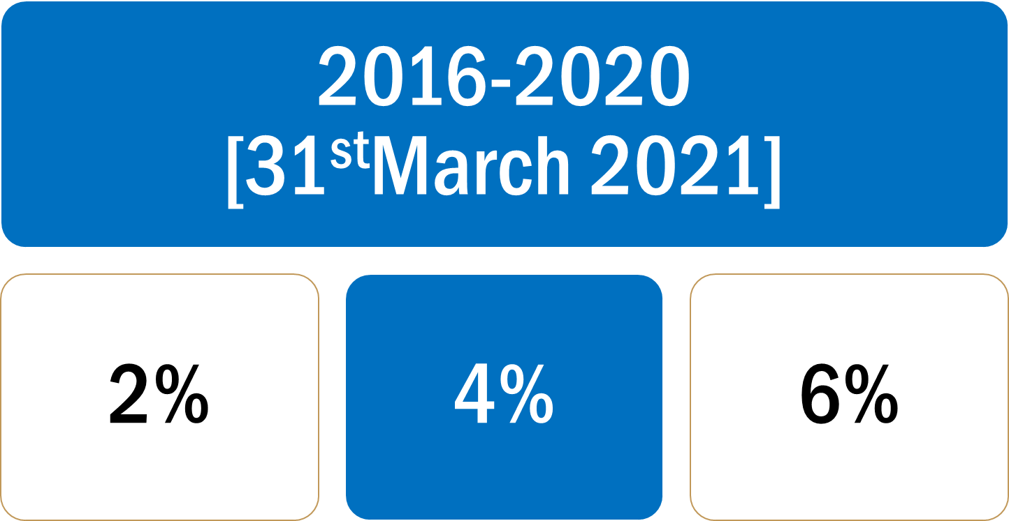
Transparency and accountability within RBI Act
MPC
Minutes of the meeting have to be published on 14th day.
Min.4 meetings a year. [HW: what’s the rule in parliament?]
Every 6 months “Monetary policy report”.
Government can send message in writing.
Target fail: report to Government with reasons and remedies.

Slide 10
Monetary Policy: Quantitative, General, indirect Tools
Combat
CRR/SLR
▼
Inflation
Deflation
Money?
Tight / Dear
Easy / Cheap
▲
Policy Rate (Repo Rate)
▲ (hike)
▼
OMO|MSS*
Sell
Buy
Money supply
▼
▲

Slide 11
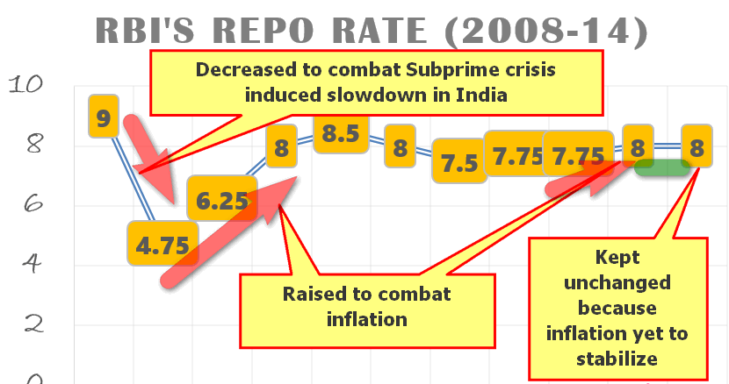
first general overview of trend since GFC.. then we’ll focus on last one year
RBI repo rate trend: 2008-13

Slide 12
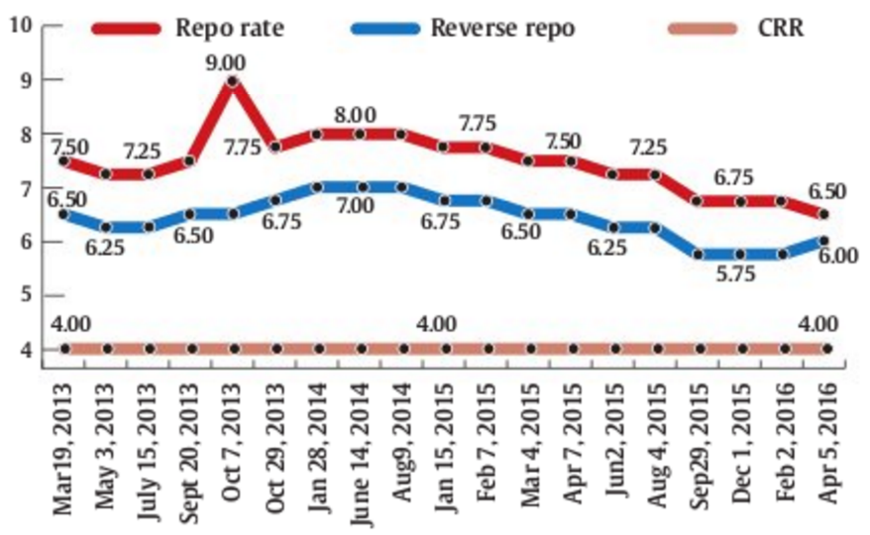
All points not plotted here
Being Raised to fight inflation
Being reduced to boost growth & demand
Before Rajan
45 days review
Rajan starts 60days
(bi monthly from 2014)
Notes:
Modi became PM on 26 May 2014.

Slide 13
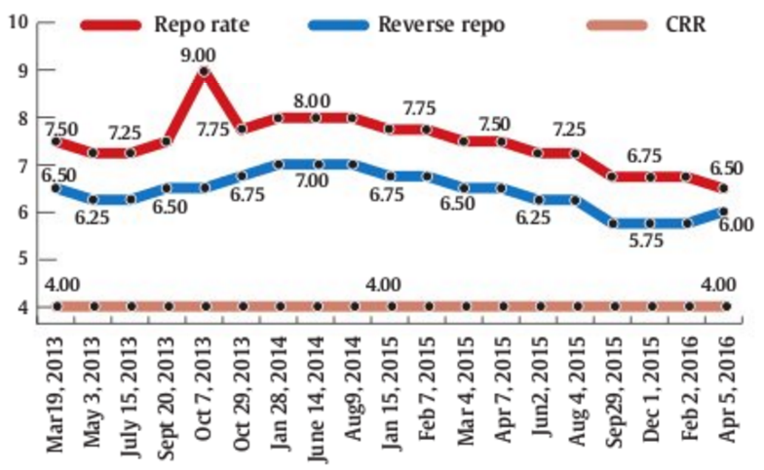
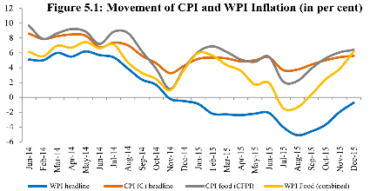
Being reduced to boost growth & demand
Urjit Patel Committee suggestion: Repo > CPI
Keeping repo rate high…helps controlling inflation.

Slide 14
Bi-monthly monetary policy: (Policy rate=REPO RATE)
Monetary policy review:
Before Rajan: @every 45 days
Since Rajan: @every 60 days (bi-monthly)
In one financial year, max. 6 bimonthly policies can be made
Since MSF and RR are tied with Repo, so we are not focusing on that.

Slide 15


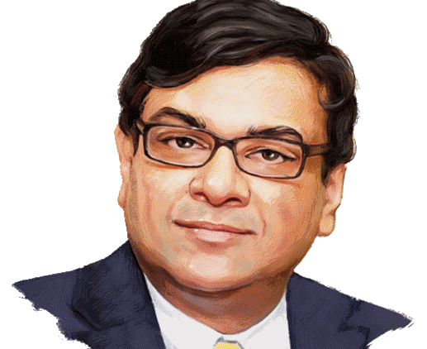
RBI Act Section 45-ZB
MPC starts functioning
Inflation target: 2%-6% CPI for 2016-2020
4th Sept 2016: 24th governor
8th Dy.Gov to become governor
Bhai: 2013 to 16 (3 years)
Urjit: 2016 to 19 (3 years)

Slide 16

2016: 1st Monetary Policy: Rate cut by __ basis points?
Unsold real-estate inventories…need to boost demand
Election season: 50-60k more out than anticipated..money multiplier affected…hence banks need more REPO borrowing.
Policy corridor narrowed from 1.00% to 0.50% [Ref previous PPT]
Daily CRR maintenance 95% -> 90%
P2P lending, Vision-2018 for digital payment cyber security
should not disclose defaulters' name in arbitrary manner.

Slide 17

2016: 2nd Monetary Policy
No change..Hold till the banks reduce lending rates.

Slide 18
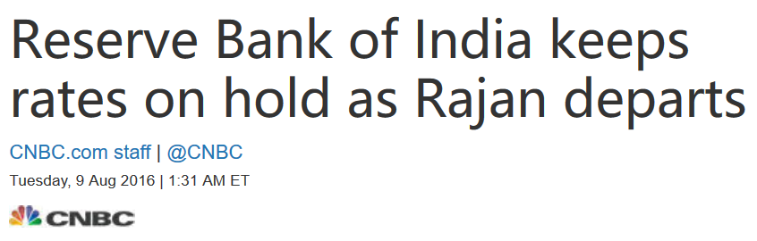
2016: 3rd Monetary Policy
hold till Banks reduce lending rates.
GST will have only short term inflation like Malaysia.
SWAMY: Rajan’s “hawkish” stand= MFG hurt.
Rajan: “sustainable inflation control, growth, job creation”…impact after 5-6 years middle income country... [GNI Per capita $1500->$6000 only then poverty will end.]
Not seeking reappointment, दुआओमें याद रखना

Slide 19
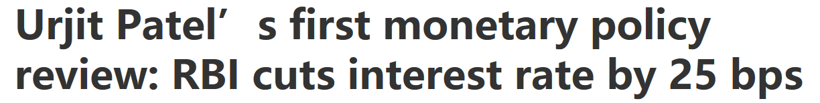
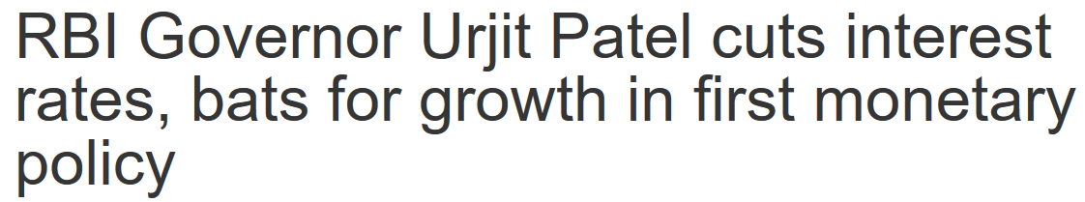
2016: 4th Monetary Policy (Urjit & MPC’s first)
Better sowing, El-Nino down, boost demand & advance purchase.
AIFI: shift to from BASEL-I to III norms from 1/1/18
startup allowed ECB upto $3 million/Per Fin Year

Slide 20
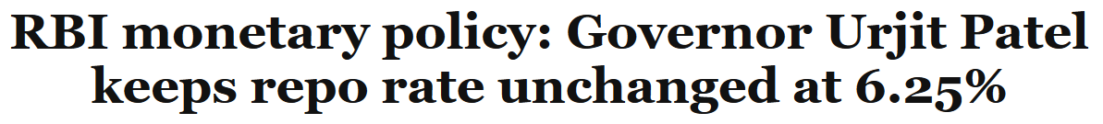
2016: 5th^{th} Monetary Policy (Urjit & MPC’s second)
Food inflation will decline, but HOLD: banks not decreasing lending rates sufficiently.
Demonetization: Incremental CRR, MSS hike. Demon=windfall profit for RBI =larger dividend..wrong theory. (more in NPA)
Thinking of bank account portability with adhar.
Govt oil bonds eligible under LAF-Repo

Slide 21
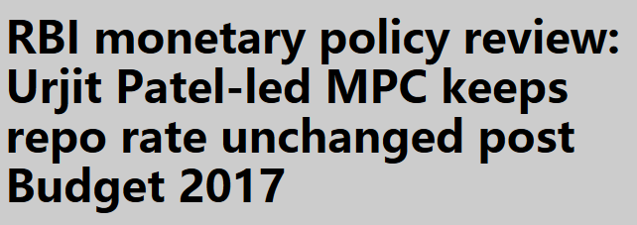
2016:6th Monetary Policy (Urjit & MPC’s third!)
HOLD: 1) banks not decreasing lending rates sufficiently. 2) BREXIT roadmap, Trumpism (Protectionism), OPEC to cut oil supply..wait and watch.
Cash withdrawal limits removed from 13/3/17.
new enforcement Department in RBI from 1/4/17.

Slide 22
Monetary Policy: Tools & their limitations
Quantitative/Gen./Indirect
Qualitative: Selective, Direct
Reserve Ratios (CRR, SLR)
Margin / LTV
OMO & MSS
Rates: Bank, MSF, LAF [Repo, RR]
Consumer Credit control / EMI
Selective Credit Control (SCC), Credit ceiling & Rationing, PSL
Moral Suasion & Direct Action
done: Review of last year’s Policies

Slide 23

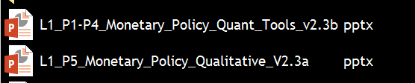
Old material is “Demonetized” “Decontentized”

